Slide 1
PROJECT DESIGN PROCESS - 1

Slide 2
TEAM DETAILS :
TEAM ID | PNT2022TMID32216
PROJECT NAME | CONTAINMENT ZONE ALERTING APPLICATION

Slide 3
PROJECT DESCRIPTION :
PROJECT IDEA :
This application is intended to provide information about containment zones in a particular region by alerting people, through continuous monitoring of an individual's location. Key benefits of the application are monitoring people's activity and alerting them to their safety movements.

Slide 4
SOLUTION REQUIREMENT :
The project aims at building an application that provides information about the containment zones of a particular region by continuously monitoring an individual's location. The location of the individual must be stored in the Database. Alerts are sent using the notification service.

Slide 5
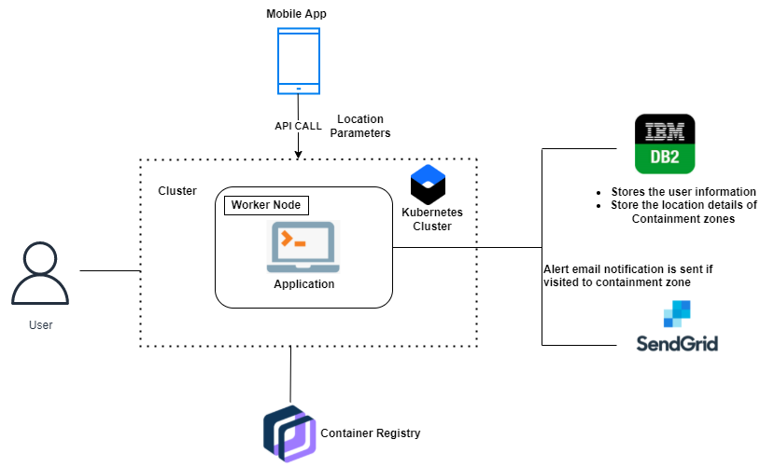
TECHNICAL ARCHITECTURE :
MODEL – 1:

Slide 6
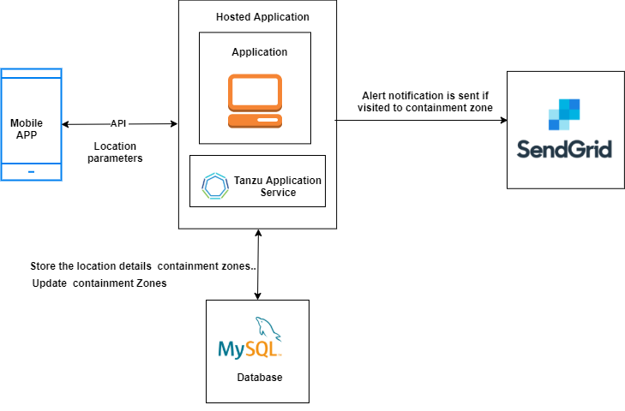
TECHNICAL ARCHITECTURE :
MODEL – 2 :

Slide 7
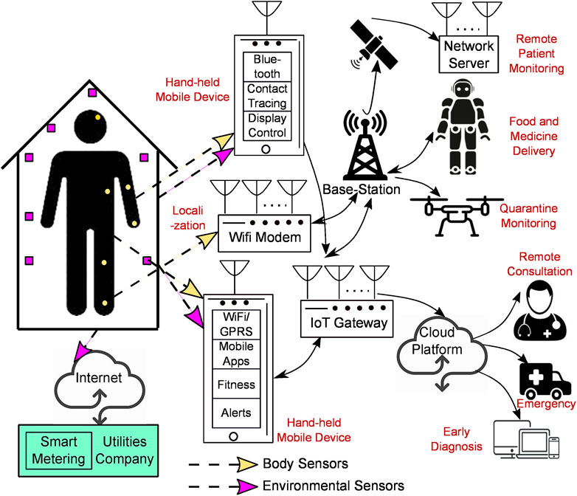
WORK FLOW :

Slide 8
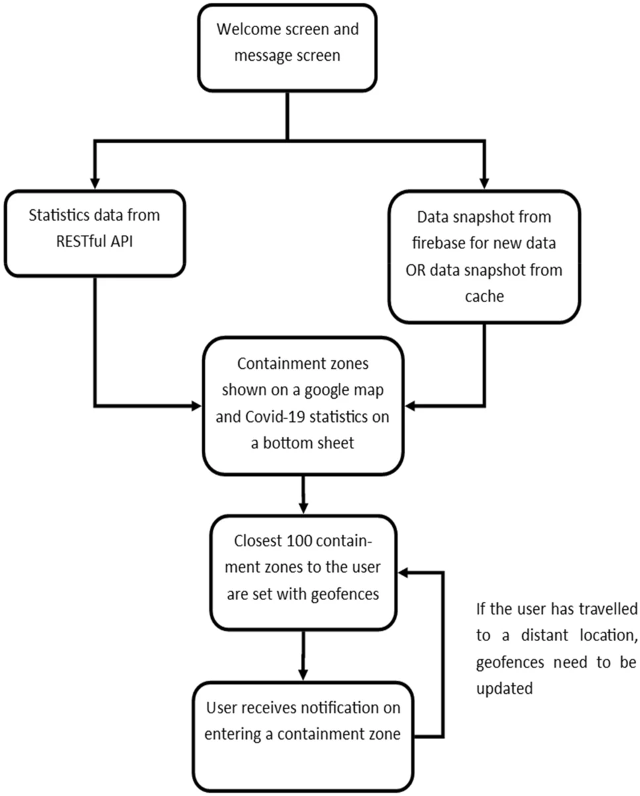




















USER
Welcome screen and message screen.
Statistics data from RESTful API
Data snapshot from firebase for new data or data snapshot from cache.
Containment zones shown on a google map & disease statistics on bottom sheet.
disease
Closest too containment zones to the user are set with geofences.
If the user has travelled to a distant location geofences need to be updated.
User receives notification on entering a containment zone.

Slide 9
THANK YOU …

